Slide 1
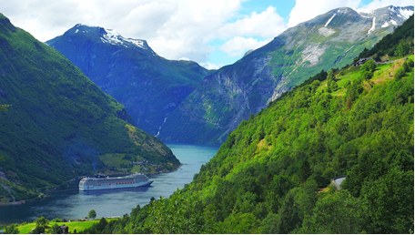
Towards the establishment of JSPS Alumni Club in Norway (ACN)
JSPS Stockholm Office
Director, Tadaharu Tsumoto, MD,PhD

Slide 2
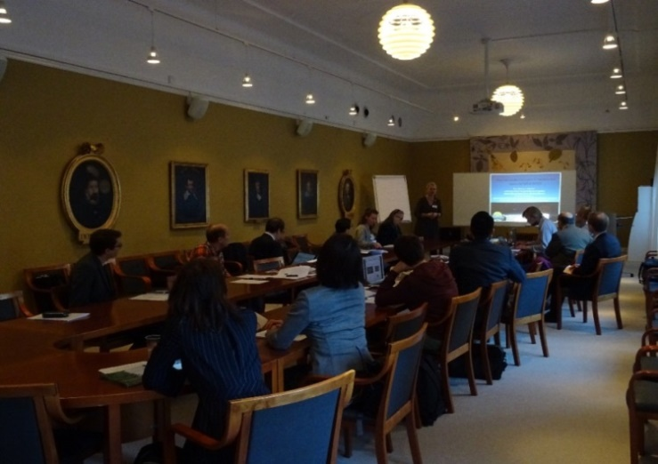
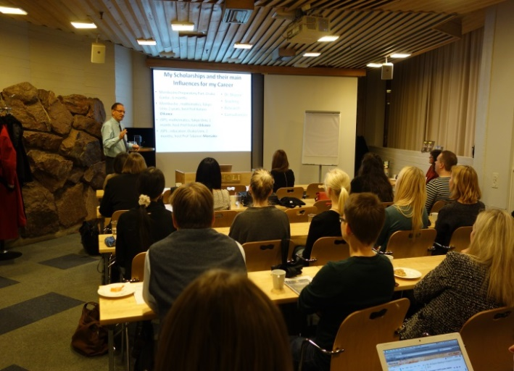
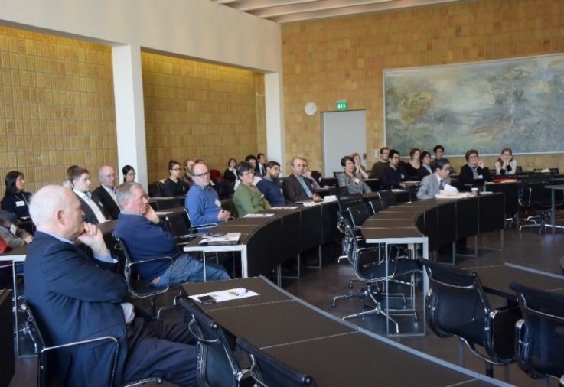
Alumni Clubs in the Nordic Countries
The JSPS alumni clubs form and maintain close networks among former JSPS fellows, and JSPS supports the operation of alumni communities.
JSPS Alumni Club in Sweden (SAC) | JSPS Alumni Club in Finland (ACF) | JSPS Alumni Club in Denmark (ACD)
established in 2005 about 160 members at present | established in 2009 about 90 members at present | established in 2015 about 40 members at present
Notes:
The third is forming a researcher community.
The JSPS supports for Alumni Associations to form and maintain close networks among researchers who have received support from JSPS.

Slide 3
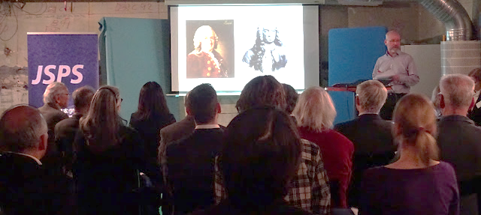
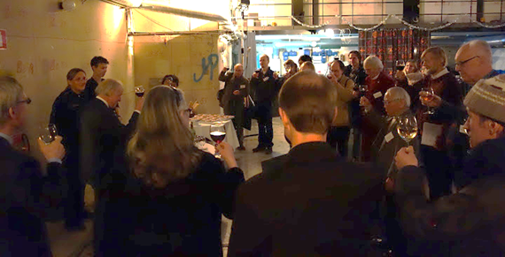
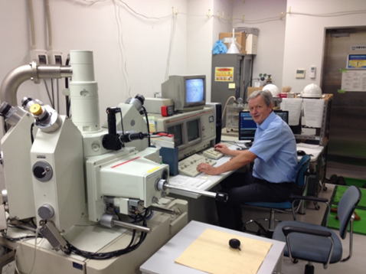
An example of Activities of JSPS Alumni Club
To form a researcher network in Sweden by SAC (Swedish Alumni Club)
Application to BRIDGE
Fellowship Program
Providing opportunities for former
JSPS fellows to revisit Japan for
creating, sustaining or strengthening
collaborative relations with
Japanese colleagues.

Slide 4
Process for the establishment of Alumni Club in Norway
researchers community
① Suggest
② Support
JSPS Stockholm Office
③ Establishment
JSPS Alumni Club in Norway

Slide 5
The expected results of Alumni Club in Norway ①
Forming International Research-Support Networks
Increasing International Joint Research between Norway and Japan.
Promoting Academic exchanges

Slide 6
The expected results of Alumni Club in Norway ②
In the future, the Alumni Clubs in the Nordic countries will together strengthen the collaboration with Japan.

Slide 7
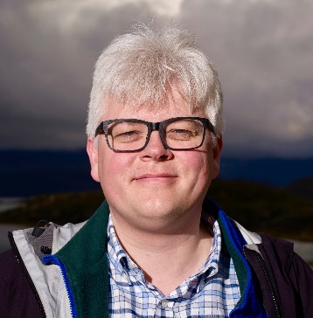
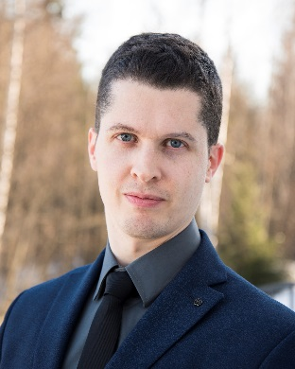
＜Activity Plan＞ May 2018, Board meeting September 2018, Kick-off meeting December 2018, Call for BRIDGE Fellowship Applications FY2019 January 2019, Board meeting and General Assembly + Norway-Japan Academic Network March 2019, Deadline for BRIDGE Fellowship Applications FY2019
Future plans of activities of ACN (tentative)
Chair Candidate
Prof. Rasmus Bertelsen
Vice Chair Candidate
Dr. Anders Øverby

Slide 8
Takk!
JSPS Stockholm Office
Director; Tadaharu Tsumoto, MD, PhD
Deputy Director; Takao Yoshihara
Staffs; Kaori Okamoto,
Fumie Yamashita,
Marika Tashima,
Viktor Granström
Retzius Väg 3, 171 65 Solna, Sweden
TEL: +46-8-5258-4561
FAX: +46-8-31-38-86
E-mail: jsps-sto@jsps-sto.com
http://www.jsps-sto.com
Facebook : JSPS Stockholm Office

