Slide 1
Japanese Government Scholarship Programs
(MEXT-scholarship programs)
Embassy of Japan in Norway
Culture and Information Section

Slide 2
MEXT-Scholarship
Monbukagakusho
(Ministry of Education, Culture, Sports, Science and Technology in Japan: MEXT)
offers three different types of scholarship for Norwegian applicants (Embassy Recommendation):
Scholarship for Japanese studies student
Scholarship for undergraduate student
Scholarship for research student

Slide 3
A. Scholarship for Japanese studies student
Scholarship for Norwegian students who wish to study Japanese language and culture in a Japanese university.
Duration: One academic year.
Scholarship Stipend: ca. JPY 117 000 (ca. NOK 9.000) per month plus tuition. Round trip air tickets provided.
Application/examination period in spring, selected students should arrive in Japan in autumn the same year. The detailed schedule will be given by the host university during the summer.

Slide 4
Requirements:
(1) Norwegian citizenship
(2) Age limit: between 18 and 30 years old
(3) University (undergraduate) student studying in a field related to Japanese language and culture.d
(4) At least one year of university level studying
(5) Sufficient Japanese proficiency for the university education
How to apply?
”Application Guidelines” and application forms can be downloaded from Japanese embassy’s website:
http://www.no.emb-japan.go.jp/mext/
Application deadline: mid February
Written examinations and interview will be organized by the Japanese embassy towards the end of February.

Slide 5
B. Scholarship for undergraduate student
Duration: 5 years (with possibility of extension) undergraduate education (humanity, social science, natural science, technology , medicine, etc.)
First year: preliminary Japanese language training.
Grant: Ca. JPY 117 000 (ca. NOK 9.000) per month plus tuition. Round trip air tickets provided.
Age limit: between 17 and 22 years old.

Slide 6
C. Scholarship for research student
Scholarship for Maximum 2 years for graduate school level education and research in major in field of speciality (humanity, social science, natural science, technology, medicine, etc.)
Grant: ca. JPY 143.000 (ca. NOK 11.000) per month plus tuition. Roundtrip air tickets provided.

Slide 7
Study starts: In April or September
Applicants can apply for up to three specific universities in priority order, or sent an open application.
Requirements:
Bachelor‘s degree or equivalent from university or university college (høgskole)
Willing to learn Japanese and to receive instructions and guidance in Japanese.
Age limit: under 35 years old.

Slide 8
Application deadline for
B. Scholarship for undergraduate student and
C. Scholarship for research student
Late spring – early summer (May – July)
Further information will be announced at Japanese embassy’s website around March-April.

Slide 9

Study in Japan Website:
http://www.studyjapan.go.jp/en/index.html
>Japanese Government (Monbukagakusho) Scholarship Students

Slide 10
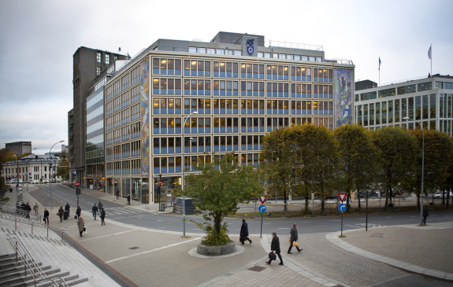
www.no.emb-japan.go.jp
www.facebook.com/japansambassade
info@os.mofa.go.jp

