Slide 1

Introduction of Japan Society for the Promotion of Science (JSPS)
JSPS was established in 1932 through an endowment by Emperor Showa.
Now JSPS is Japan’s Core Research Funding Agency supporting the advancement of scientific research in all fields mainly by annual subsidies from the Japanese Government.
JSPS Stockholm Office
Director, Tadaharu Tsumoto, MD,PhD
Notes:
Good morning, ladies and gentlemen. My name is Tadaharu Tsumoto, Director of JSPS Stockholm Office. It is my great pleasure to see this Japan-Denmark Workshop on Biomass Research here in Technical University of Denmark today. As one of the supporters of this symposium, I would like to thank everyone here for joining this workshop today, and to introduce activities of JSPS and JSPS Stockholm Office.

Slide 2
JSPS supports curiosity-driven researches in natural/social sciences, engineering and humanities. In principle, no priority field.
JSPS funds
  - Grant to research projects: Grant-in-Aid:
  (Total, ca.2 billion € /70,000 projects/year)
    For researchers at Japanese Institutions, regardless
    of their nationality.
  - Fellowships: ca.6,000 Japanese pre-/post-docs.
  - International collaborations: Bi- & multi-lateral programs
  Mobility facilitation by international programs (per year):
  ca.10,000 researchers from pre-docs to professors
3/16
Notes:
This slide shows the key figures of JSPS.
We support bottom-up research, driven by researchers curiosity, not mission-oriented research.
We don’t have any priority area. Therefore support all research fields using these supports.

Slide 3
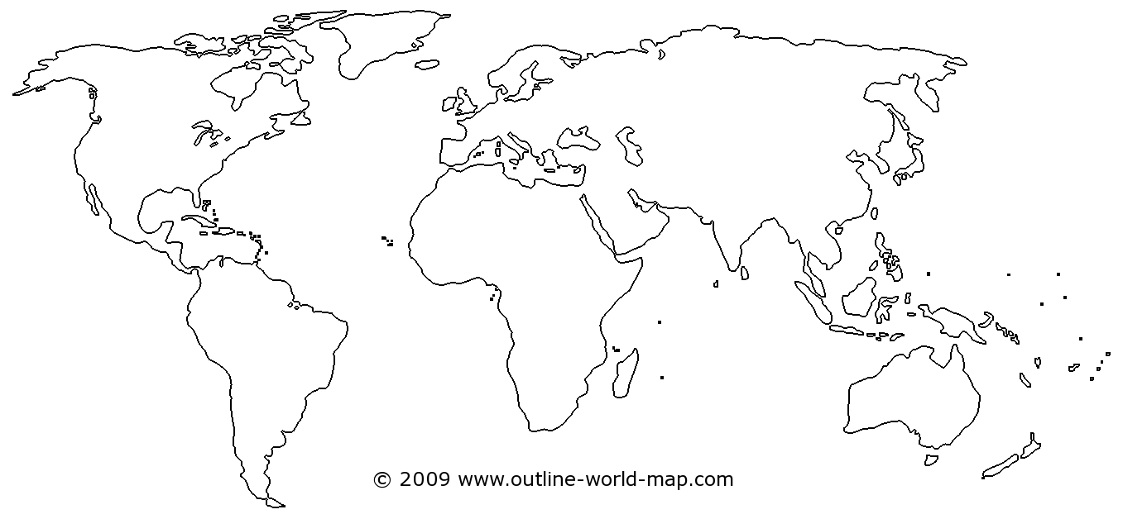
Ten JSPS Overseas Offices and Stations in the World to Build Robust International Cooperative Networks
JSPS London Office
JSPS Stockholm Office
JSPS Washington Office
JSPS TOKYO
JSPS Bonn Office
JSPS Strasbourg Office
JSPS Beijing Office
JSPS San Francisco Office
JSPS Bangkok Office
JSPS Cairo Research Station
JSPS Nairobi Research Station
5/16
Notes:
To promote collaboration with European Countries, JSPS has 4 overseas offices in Europe; London, Bonn, Strasbourg and Stockholm.
Each JSPS office has strong linkages with each and neighboring countries’ academic organizations.
Through these networks, every year, more than 1,300 Europe-based researchers visit Japan, and more than 2,100 Japanese researchers visit Europe, with JSPS international programmes.
（人数には、EU以外の欧州諸国を含む。旧ソ連諸国も欧州としてカウント。トルコは「中東」なので欧州にはカウントされていない。）
（交流人数は、国際交流事業＋海外特別研究員のみの集計。特別研究員や科研費は含まれていない。）

Slide 4
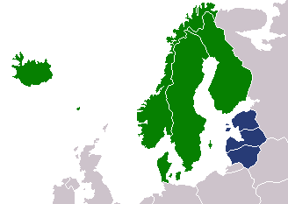
Mission of JSPS Stockholm Office
Building robust international cooperative networks between Japan and Nordic and Baltic countries
Notes:
JSPS Stockholm Office was founded in 2001 as one of ten overseas offices around the world to promote international research collaboration with Japan.
Mission of our office is building robust international cooperative networks between Japan and Nordic and Baltic countries.
We are active in creating and developing successful people partnerships between each country and Japan through a wide range of activities.

Slide 5
Activities of JSPS Stockholm Office
Holding seminars, symposia and workshops with Nordic/Baltic and Japanese universities
to promote joint researches
to stimulate students/researchers exchange
(2) Collaborating with partner institutions
Research Council of Norway (RCN)
Universities Denmark (DU)
Academy of Finland (AF)
Estonian Research Council (ETAg)
Research Council of Lithuania (RCL)
Swedish Foundation for International Cooperation in
Research and Higher Eductaion (STINT)
Swedish Foundation for Strategic Research (SSF)
Swedish Governmental Agency for Innovation Systems (VINNOVA)
Royal Swedish Academy of Sciences (KVA)
Royal Swedish Academy of Engineering Sciences (IVA)
Notes:
What is our activities?
The first of our main activities is holding academic seminars and symposia with Nordic/Baltic and Japanese universities.
The second is collaborating with partner institutions to hold seminars and to implement JSPS Fellowship Programs.

Slide 6
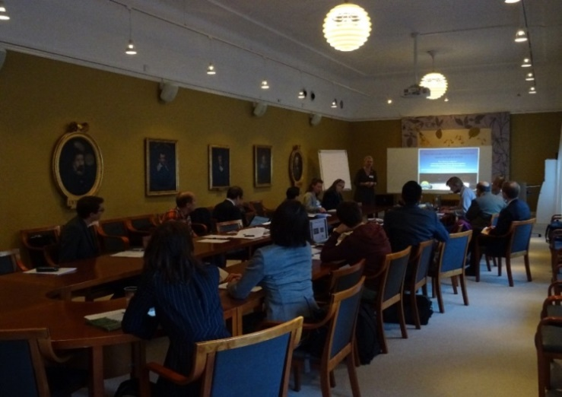
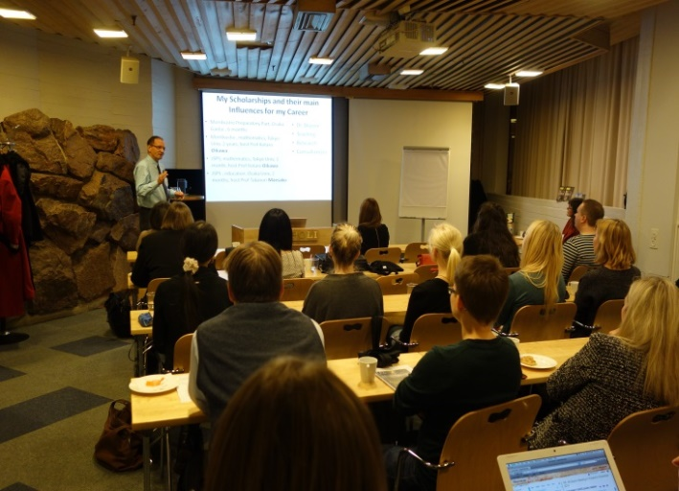
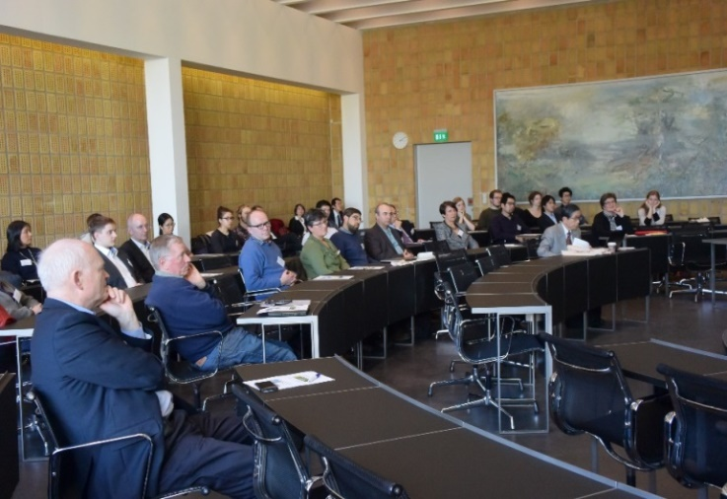
Activities of JSPS Stockholm Office (cont.)
(3) Establishing Alumni Clubs
The JSPS alumni clubs form and maintain close networks among former JSPS fellows, and JSPS supports the operation of alumni communities.
JSPS Alumni Club in Sweden (SAC) | JSPS Alumni Club in Finland (ACF) | JSPS Alumni Club in Denmark (ACD)
established in 2005 about 160 members at present | established in 2009 about 90 members at present | established in 2015 about 40 members at present
Notes:
The third is forming a researcher community.
The JSPS supports for Alumni Associations to form and maintain close networks among researchers who have received support from JSPS.

Slide 7
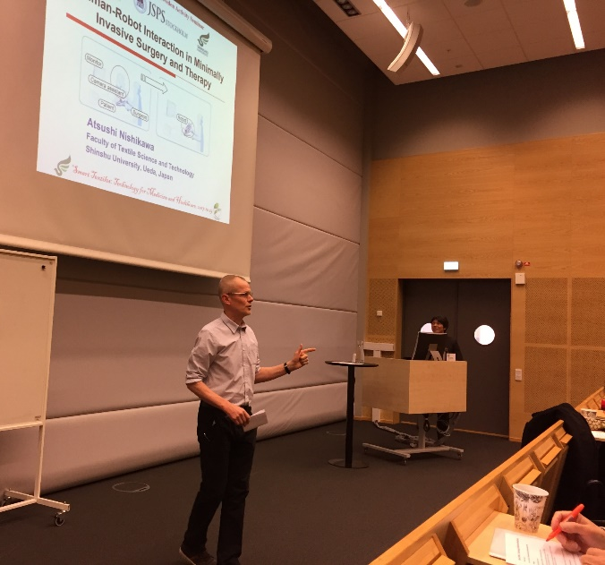
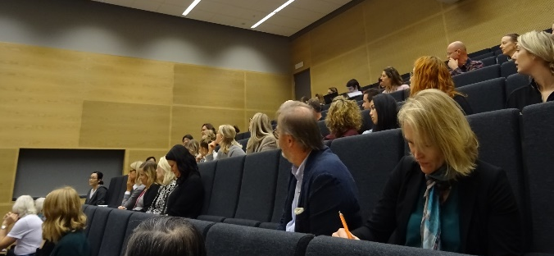
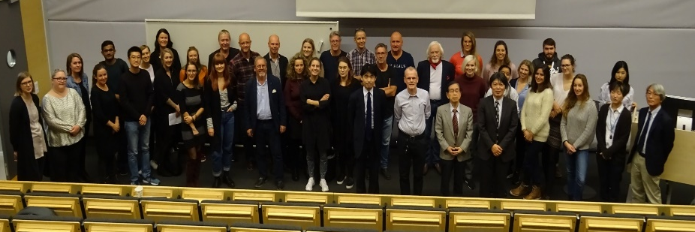
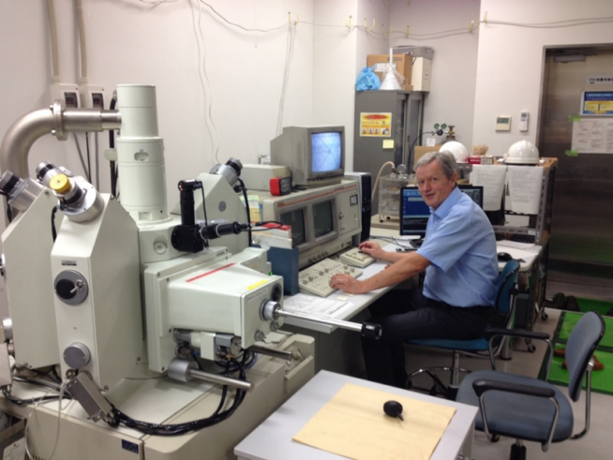
An example of activities of Alumni Clubs
Activity Seminars, General Assembly and Board Meetings
A SAC Activity
Seminar at Borås,
Sweden on 19th
October 2017
BRIDGE Fellowship Program
JSPS Alumni Club members can revisit Japan for strengthening
collaborative relationship
Notes:
JSPS offers financial support for Alumni Clubs to hold Activity Seminars, General Assembly and Board meetings annually to form and maintain close networks among former JSPS fellows.
As an activity of Alumni Association, we also have BRIDGE Fellowship Program only for Alumni Club members.
This program provides opportunities for former JSPS fellows to revisit Japan for the purpose of creating, sustaining or strengthening collaborative relations with Japanese colleagues.

Slide 8

JSPS International Programs
(1) Fellowship Programs
Fellowships to Japan
PhD
Postdoc （6 years after PhD）
Mid-career
Professor
Distinguished Professor
M.phil
Postdoctoral Fellowships
Invitational Fellowships
(Standard)
1 - 2 years
(Long-Term)
61 days –
10 months
(Short-Term)
14 - 60 days
(Short-Term S)
7 - 30 days
(Short-term)
1 - 12 months
Summer
Program
Support all research fields
43 researchers/students in the Nordic and Baltic countries to Japan in FY2016
2 months
8/16
Notes:
Here are JSPS Fellowship programmes for European researchers to visit Japan.
JSPS Fellowship programs support all career stages, from PhD students to senior professors, and support all research fields.
We basically provide return air ticket, maintenance allowance and research support allowance.
These programmes do not aim to recruit international students to Japanese universities, but aim to develop research collaboration between Japan and overseas countries for scientific benefit of both the countries.
In FY2015, more than 600 Europe-based researchers visited Japan by JSPS Fellowship programmes.
※Summer Programmeの欧州の対象国は、イギリス、フランス、ドイツ、スウェーデンのみ。国籍等の申請資格は各国のNominating authoritiesが定めているが、基本的にその国の国籍が必要。
※Postdoctoral Fellowship (Short term）の欧州の対象国は、EU加盟国、スイス、ノルウェー、ロシア。基本的にその国の国籍が必要。ただし、対象国の大学等で3年以上研究を継続中であれば、それ以外の国籍でも申請可能。

Slide 9
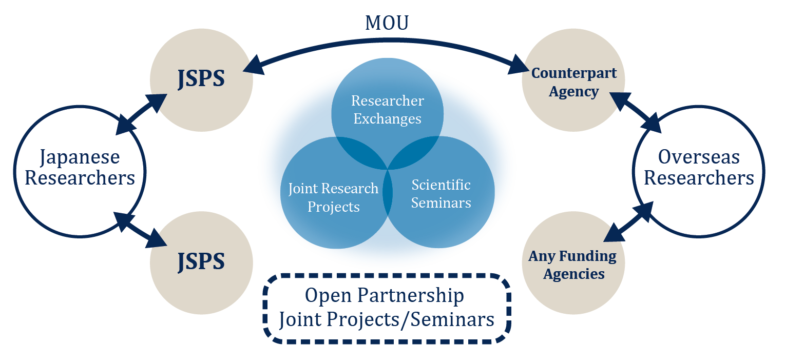
JSPS PROGRAMS
(2) Bilateral Programs (up to 3 years)
The aim of these programs is to form sustained networks
which have evolved from individual scientist exchanges
including young scientists.
Program between Japan and Norway; e.g., between Dr. M. Shimizu in Hokkaido University and Dr. Tom Ole Nilsen in Uni Research AS from 1 October 2015 to 30 September 2017.
Notes:
Thirdly, JSPS has Bilateral Programs.
The aim of the programs is to form sustained networks which have evolved from individual scientist exchanges.
JSPS promotes international scientific exchanges between Japan and counterpart countries in accordance with agreements. In Sweden, STINT is our partner agency, and the programs take the form of joint seminars.
In addition to that, JSPS has another scheme for joint projects or seminars named “Open Partnership Joint Research Projects/Seminars”. That provides Japanese researchers an opportunity to do a joint research project or a seminar with researchers around the world.
Fourthly, JSPS has Core-to Core Program. This program is designed to create world-class research hubs in cutting-edge research fields and establish sustainable collaborative relations among research institutions in Japan and around the world.
We hope that you will apply these programs with Japanese researchers and enjoy your collaborative research!
Then, after you received support by these programs, we hope you will participate in the JSPS Alumni Club and continuously strengthen the collaborative relation with Japan.

Slide 10
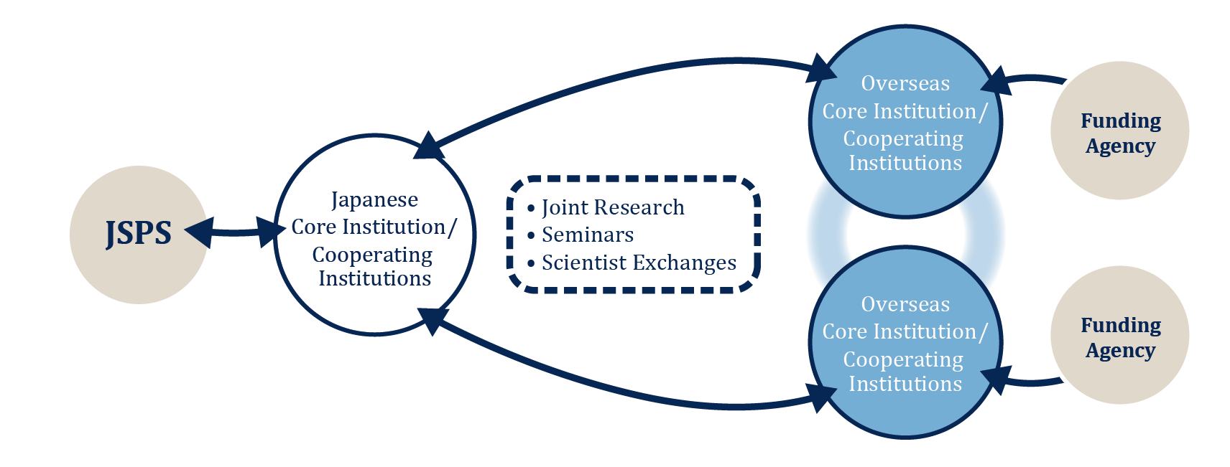
JSPS PROGRAMS
(3) Core-to-Core Program (up to 5 years)
This program is designed to create world-class research hubs
in cutting-edge research fields and establish sustainable
collaborative relations among research institutions in Japan
and around the world.
Currently one program is running between Japanese and Norway cores.
e.g., Osaka Univ. (Japanese core) – NTNU (Norwegian core) on “International Research Collaboration Network for Highly Functional Sensing Devices for Health, Safety and Security”
Notes:
Thirdly, JSPS has Bilateral Programs.
The aim of the programs is to form sustained networks which have evolved from individual scientist exchanges.
JSPS promotes international scientific exchanges between Japan and counterpart countries in accordance with agreements. In Sweden, STINT is our partner agency, and the programs take the form of joint seminars.
In addition to that, JSPS has another scheme for joint projects or seminars named “Open Partnership Joint Research Projects/Seminars”. That provides Japanese researchers an opportunity to do a joint research project or a seminar with researchers around the world.
Fourthly, JSPS has Core-to Core Program. This program is designed to create world-class research hubs in cutting-edge research fields and establish sustainable collaborative relations among research institutions in Japan and around the world.
We hope that you will apply these programs with Japanese researchers and enjoy your collaborative research!
Then, after you received support by these programs, we hope you will participate in the JSPS Alumni Club and continuously strengthen the collaborative relation with Japan.

Slide 11

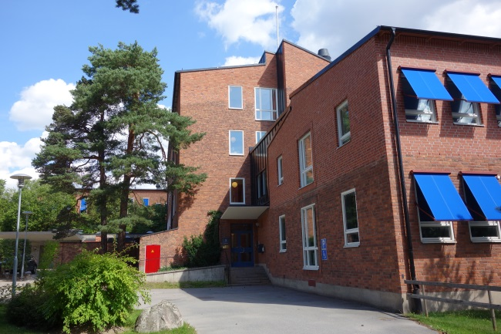
Takk!
Please contact us anytime if you are
interested in the JSPS programs.
JSPS Stockholm Office
Director; Tadaharu Tsumoto, MD, PhD
Deputy Director; Takao Yoshihara
Staffs; Kaori Okamoto,
Fumie Yamashita,
Marika Tashima,
Viktor Granström
Retzius Väg 3, 171 65 Solna, Sweden
TEL: +46-8-5258-4561
FAX: +46-8-31-38-86
E-mail: jsps-sto@jsps-sto.com
Facebook : JSPS Stockholm Office
http://www.jsps-sto.com

